Slide 1
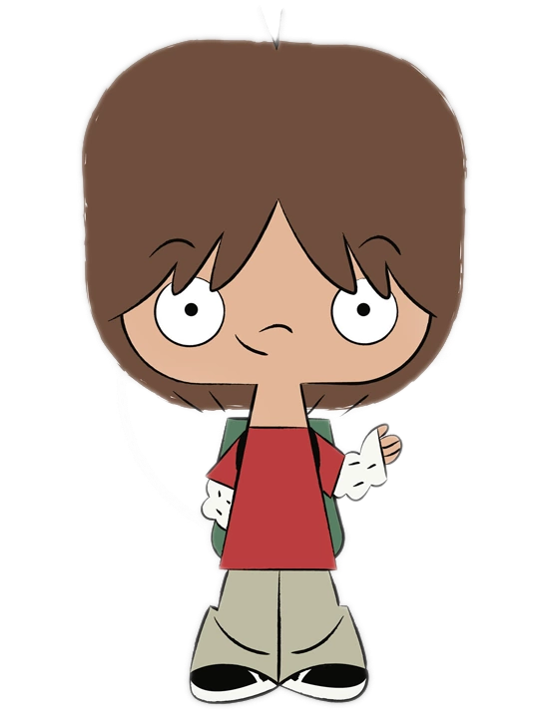
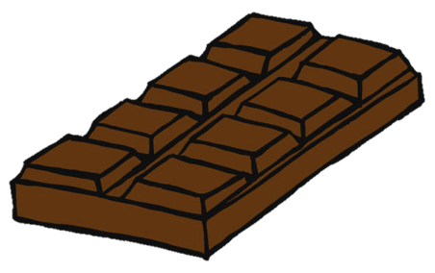
Notes:
This is Jayden. Jayden has a chocolate.

Slide 2
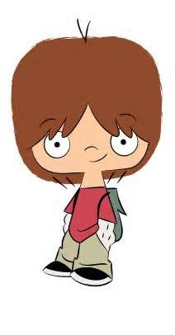
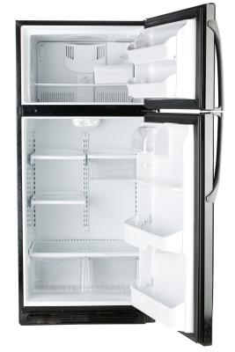
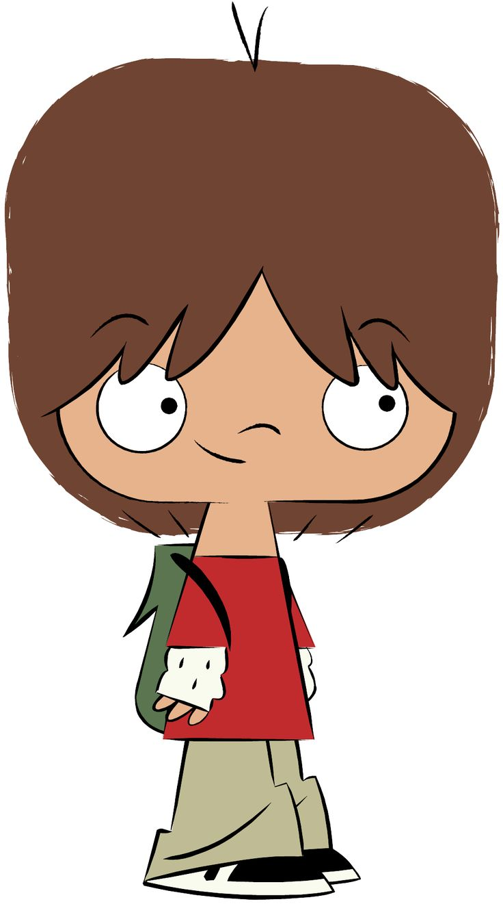
Notes:
S/he wants to save it for later and puts the chocolate into the fridge. Jayden goes out for a walk.

Slide 3

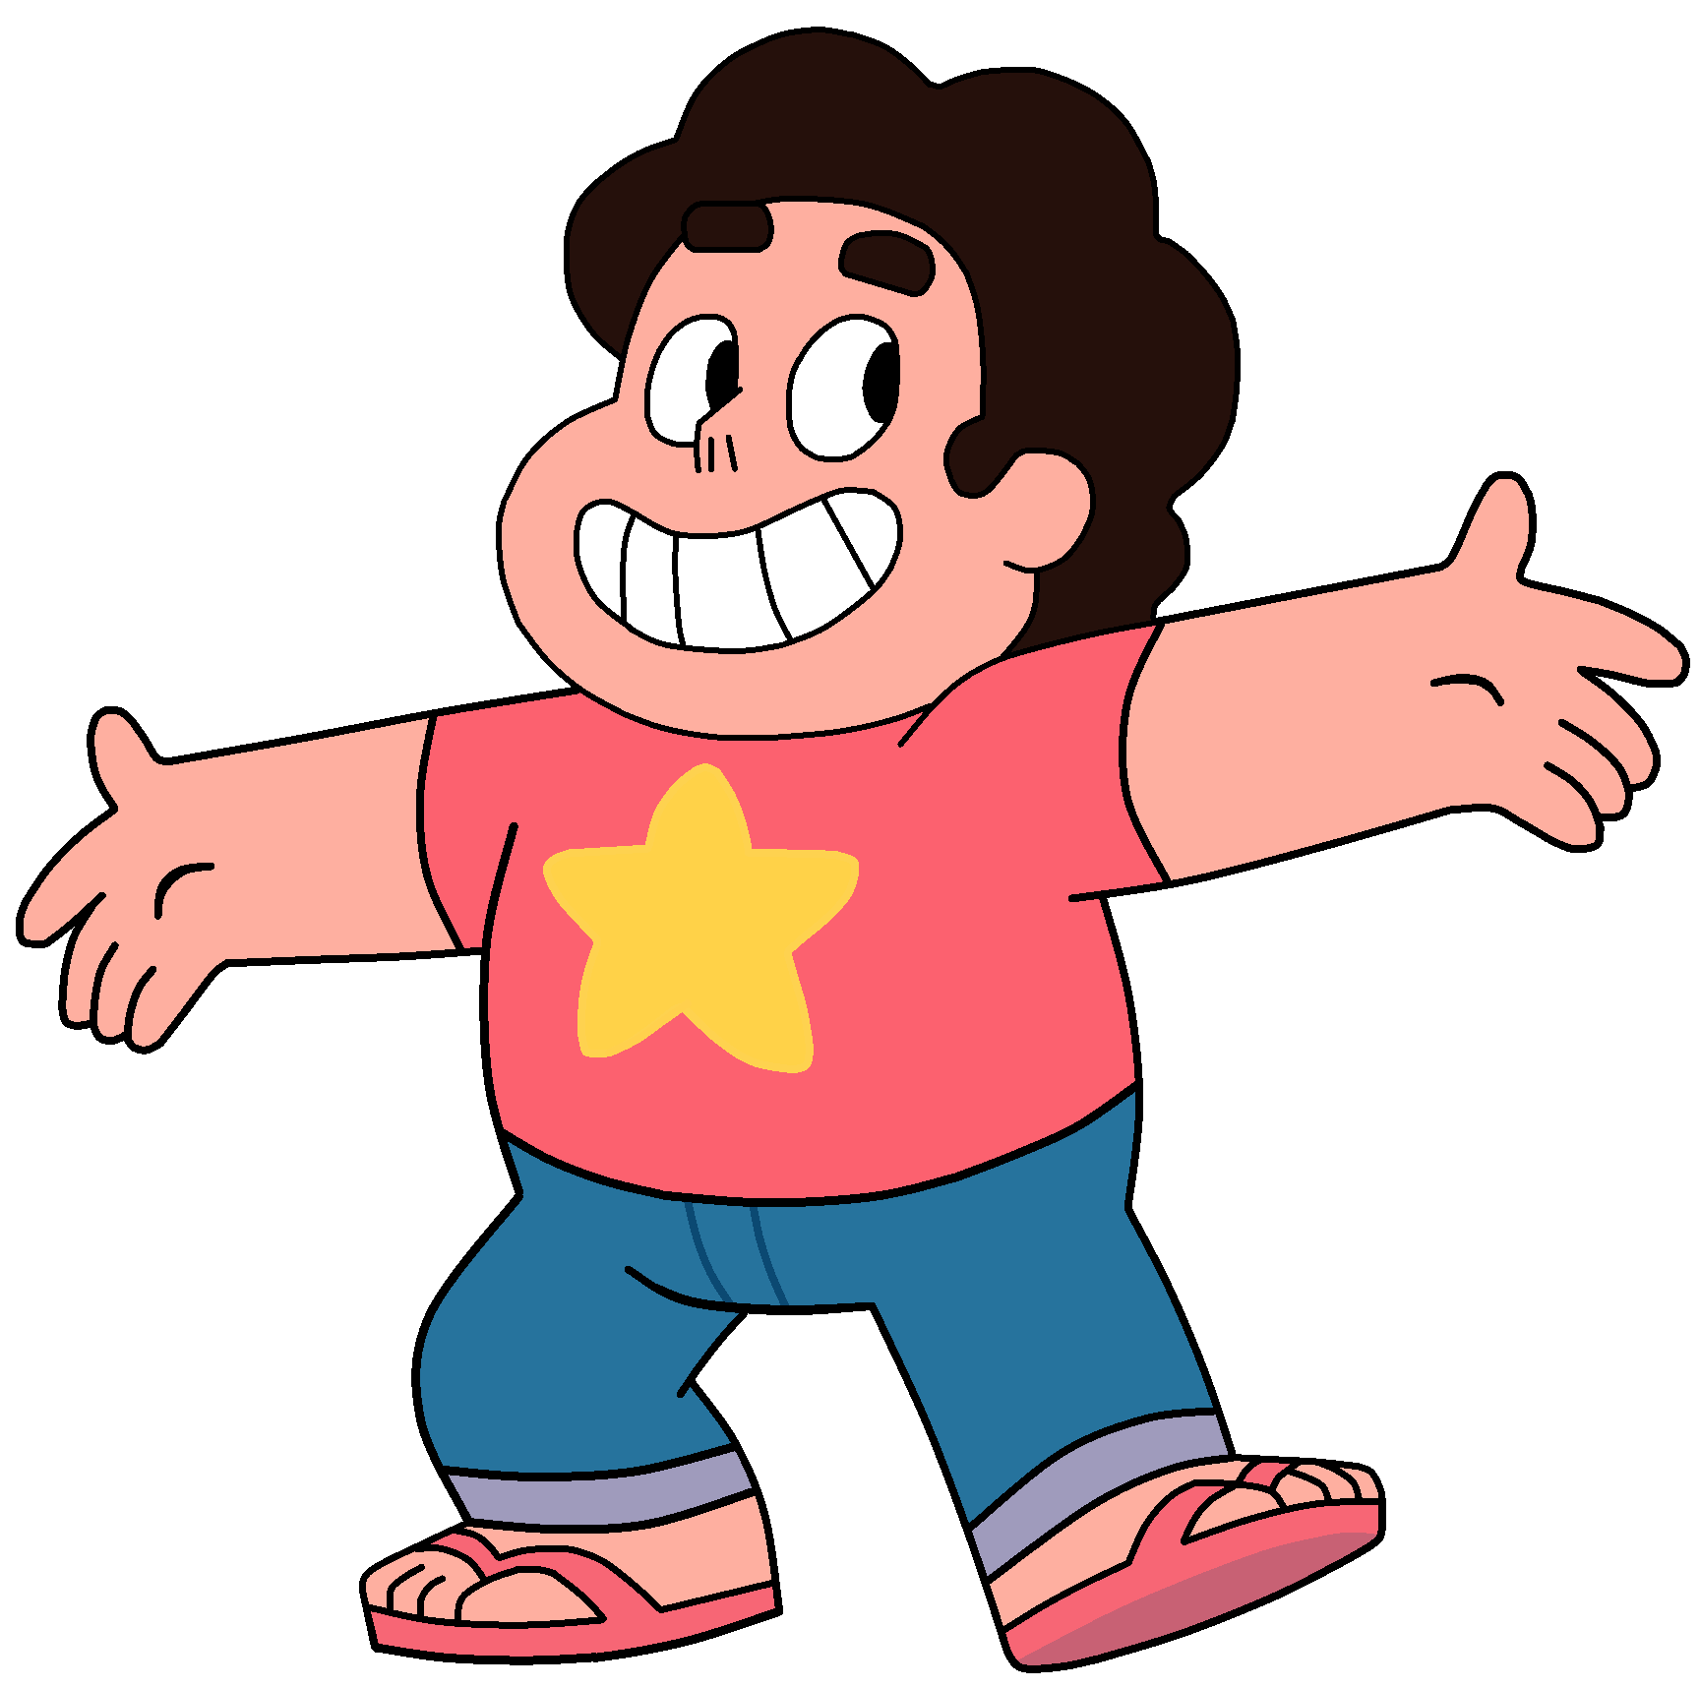
Notes:
While Jayden is gone, Eli takes the chocolate out of the fridge and puts it into the cabinet. See that -- see how he’s moving it from the fridge to the cabinet?

Slide 4
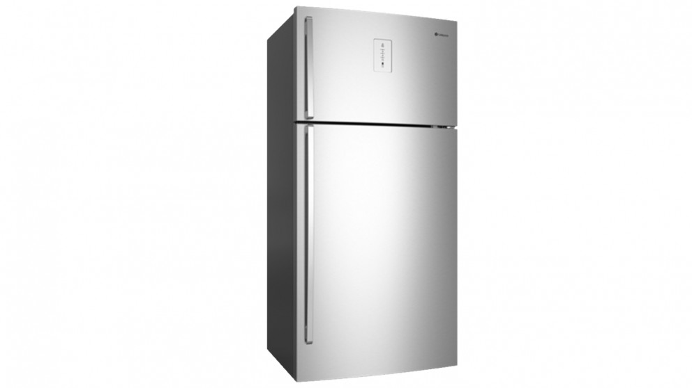
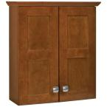
Notes:
So where did Jayden first put his chocolate? And to where is it now?

Slide 5
Notes:
Now -- see this -- Jayden is coming back. S/he wants to eat his/her chocolate.
Can you tell me -- When Jayden comes back, where will s/he first go to look for his/her chocolate?

Slide 6
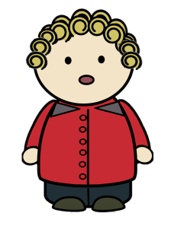
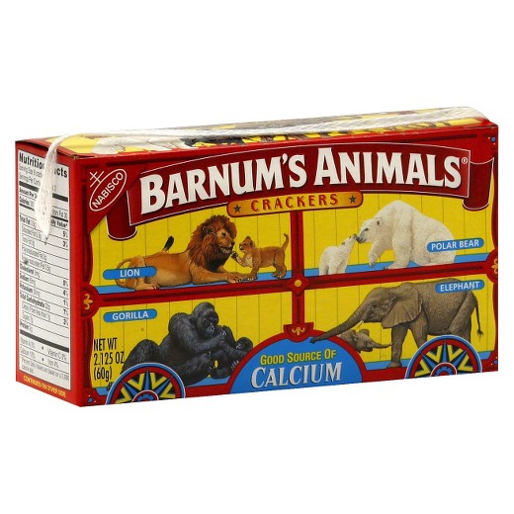
Notes:
“Here is an animal crackers box and here is Kyle. What do you think is inside the animal crackers box?”
Then the experimenter makes Kyle speak: “Oh good, because I love animal crackers. Animal crackers are my favorite snack. Now I will go take a nap.” Experimenter shows a picture of Kyle sleeping on a bed.

Slide 7
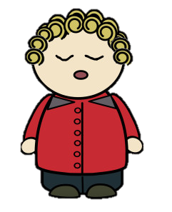
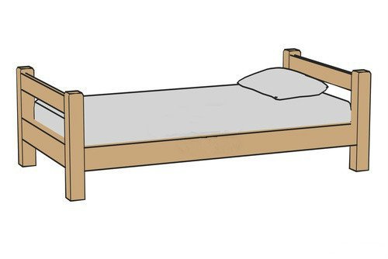
Notes:
Experimenter shows a picture of Kyle sleeping on a bed. “See Kyle is taking a nap and can’t see or hear us right now.”

Slide 8
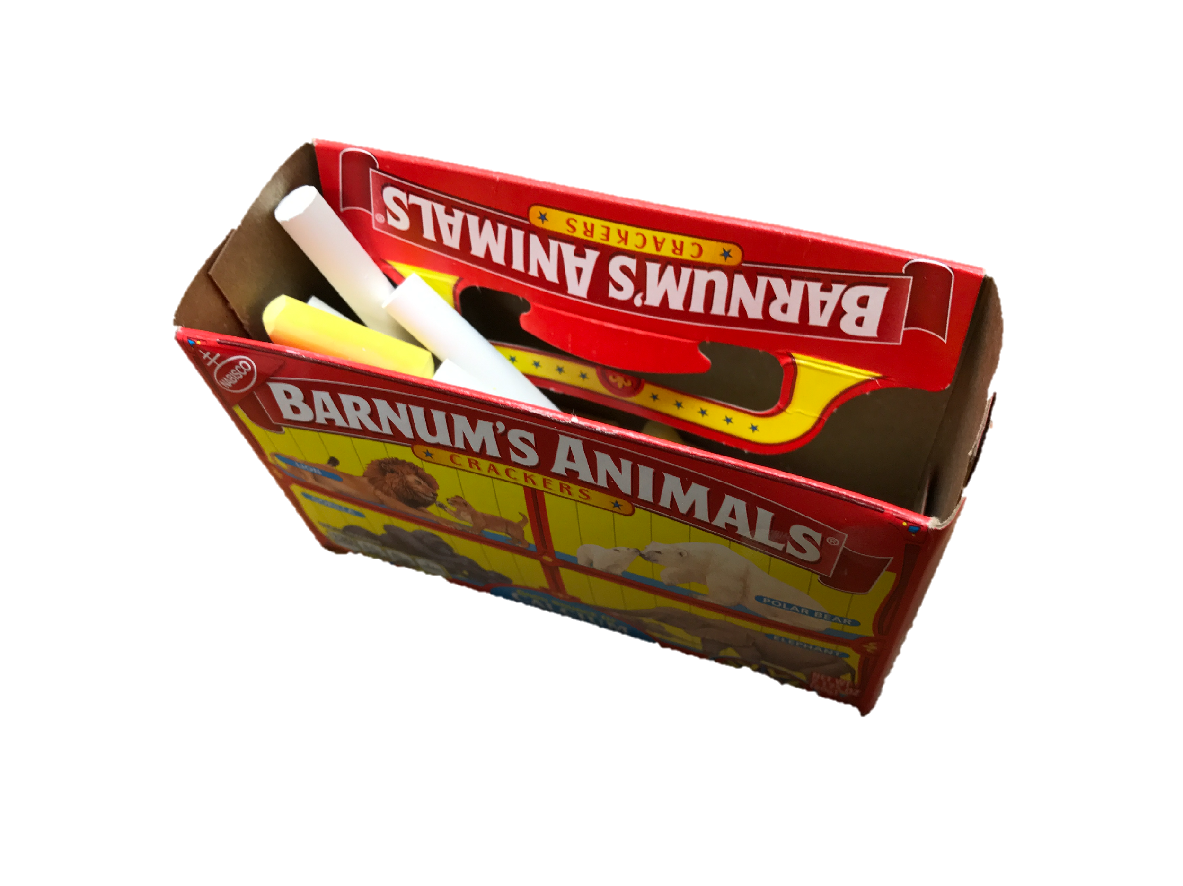
Notes:
Next, the experimenter shows a picture of the animal crackers box with chalks inside. “Let’s see. There is really chalk inside and no animal crackers! There is nothing but chalk.”

Slide 9
Notes:
Then the experimenter shows a picture of closed animal crackers box and asks the child: “Okay, what is Kyle’s favorite snack”(animal crackers)

Slide 10
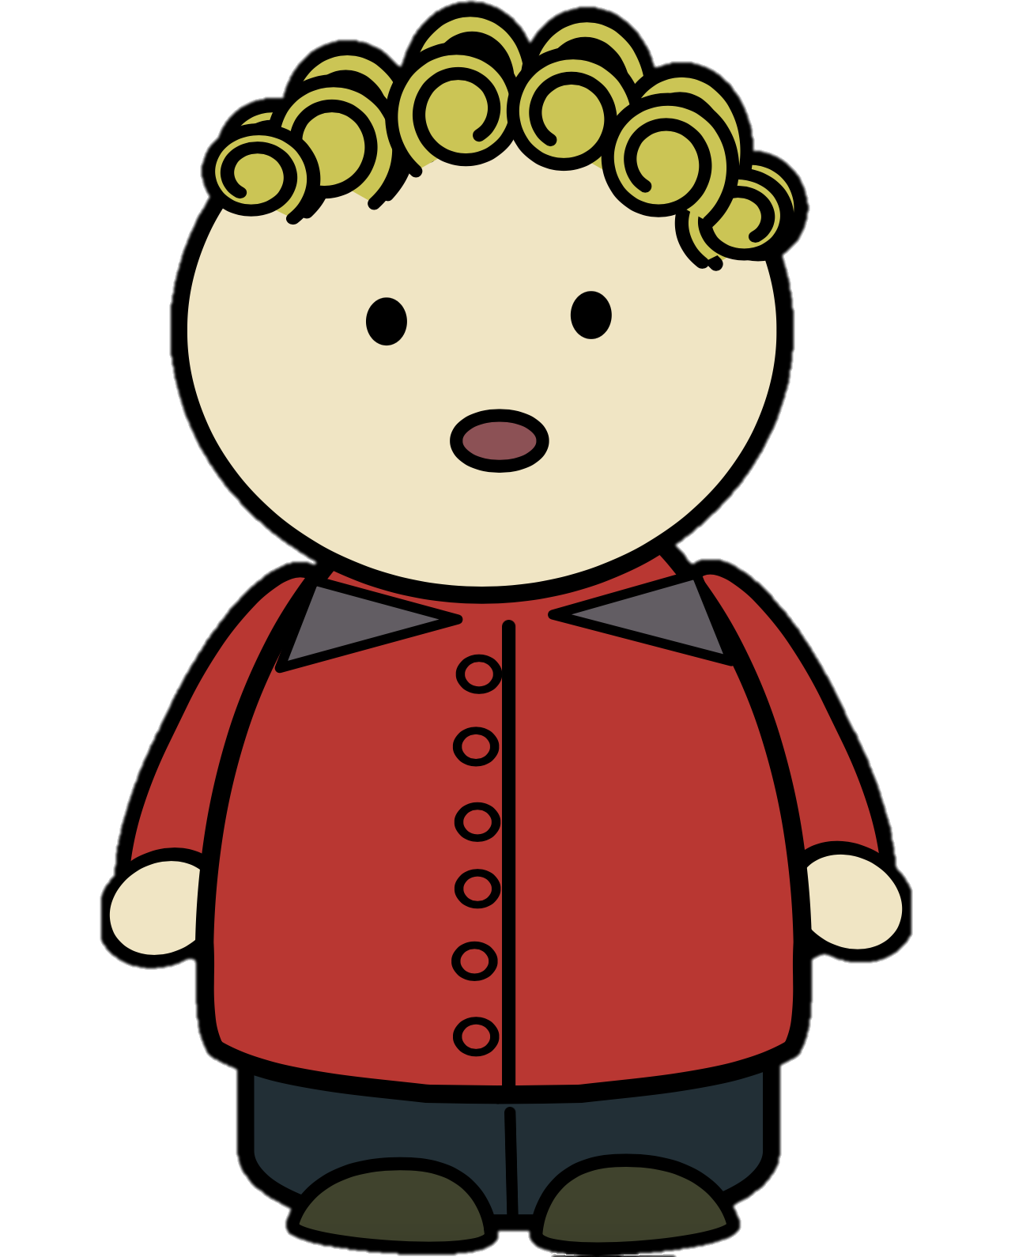

Notes:
Then Kyle comes back: “Kyle has never ever seen inside this box. Now here comes Kyle. Kyle is back and it’s snack time. Let's give Kyle this box. So how does Kyle feel when he gets this box? Happy or sad?

Slide 11
Notes:
The experimenter shows a picture of the opened the box with chalks inside and Kyle looking at the box. How does Kyle feel after he looks inside the box? Happy or sad?

